Slide 1

A VERY WARM
WELCOME!

Slide 2

“BUILDING FOUNDATIONS FOR YOUR FUTURE”.

Slide 3
Staff Inset Day
5th September 2023 2PM
Zoom link
Swansea Sixth form College is inviting you to a scheduled Zoom meeting.
Topic: SWANSEA COLLEGE ONLINE
Join Zoom Meeting
https://zoom.us/j/93620470255?pwd=RGswbGZlUTZxRTZYeUQrTjBOZXg5QT09
Meeting ID: 936 2047 0255
Passcode: Scollege23
All our meetings are recorded to safeguard and protect our teachers, staff and students.
Meeting ID: 936 2047 0255
Passcode: Scollege23
All our meetings are recorded to safeguard and protect our teachers / staff and students.

Slide 4
Important Information
Additional Maths
Our College Address:
18 Mansel Street
Swansea
SA1 5SG
Telephone number:
01792 535000
Email Addresses:
Swansea College Office
office@swanseacollege.com
Exams Office
exams@swanseacollege.com
Staff emails will be shared with students at the beginning of the course. Any emails to staff members must be copied to and include the office email address.
Please take note of this information you see on this slide.
Our website; www.swanseacollege.com

Slide 5
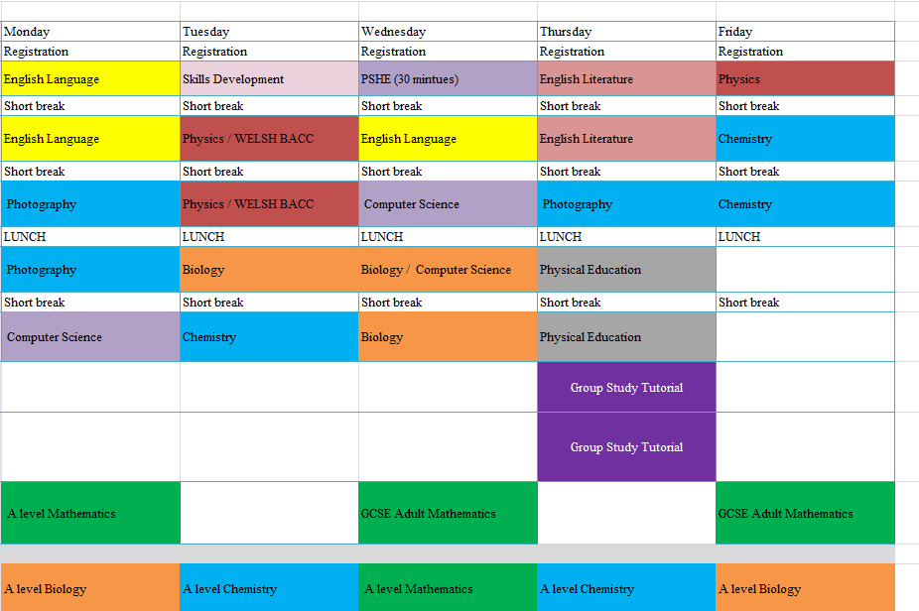
Example; Student Timetable

Slide 6
Term dates.
Terms dates
GCSE, A level & EFL dates on the website
DLC plus on the Teachers Communication Board
Bank Holidays and Inset day on website
Holidays must be taken during school holidays, if you require anytime off during term time a holiday request form needs to be completed and approved.

Slide 7
School Information and Communication
School Notice Board (on Google Classroom)
All school communication will be posted on the Google Classroom
All students

Slide 8
School Information and Communication
Teachers communication (on website - link)
Teachers Communication Board – links sent in an email
DO NOT share this link.

Slide 9
School Information and Communication
Exams Notice Board
Exams – External candidates communication

Slide 10
School Information and Communication
Emailing students; you must copy in the office email
We will save these emails in the student folder as reference
All requests, and communication by parents / students – they must email office.
Class times are fixed, if you need to rearrange a class due to an emergency, then you must contact the office by email and follow up with a phone call.
The college timetable will be posted on the TCB, so you can check when to schedule classes.

Slide 11
School Information and Communication
Teachers and Office staff
DO NOT share your telephone number or personal email with students or past students

Slide 12

Lesson plan – Attendance information given to students
Attend every lesson on your timetable
Be on time for every lesson (login 5 minutes before)
Be on time after every break
You must share your video
If you miss lessons, we will contact your parent/legal guardian.
If you miss lots of lessons we will arrange a meeting to discuss this issue.
If you are going to miss a lesson because you are ill, you must contact the college as early as possible by email – office@swanseacollege.com.
If you need to miss a lesson for an important appointment, you must request leave, and we can marked you as excused and arrange for the lessons to be sent to you.

Slide 13

Online classes
All classes are recorded
Be prepared:
Plan your day, have ready the exercise books for the day
You must be online and present at least 5-minutes before the start of your class.
Have your stationery out ready; pens, pencils, calculator, ruler, exercise books etc.
Have a bottle of water with you, have tissues next to you, go to the toilet in your breaks or before class starts.
Make notes and copy from the screen, have your textbooks to hand.
Remember to pick up your exercise books up from the Office!

Slide 14
Homework
Homework is very important, you must complete it on time.
Every class will have homework every week.
The amount of homework provided is at the discretion of the teacher.
You must make a note of homework provided- before you leave the class.
If you do not complete your homework, an email reminder will be sent to your parent/legal guardian.

Slide 15
Google Classroom
An email will be sent to you when;
Teachers/ office staff post any updates
Homework is set / uploaded
Homework is marked
We strongly advise you check your emails regularly and download the Google classroom app and Google drive on your mobile/ipad.

Slide 16
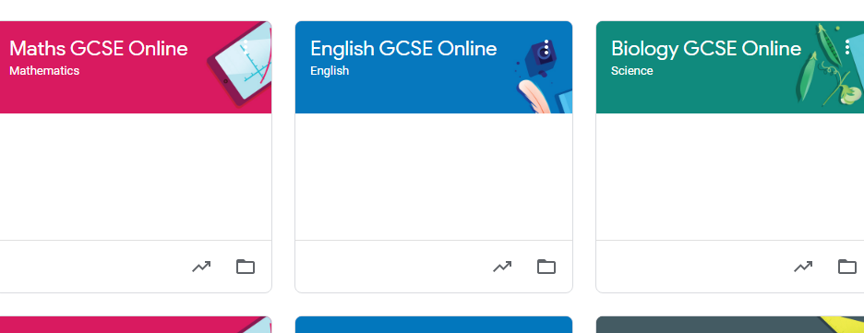
Google Classroom – training available
Subjects

Slide 17
Google Classroom – training available
An invite for all classrooms has been sent.
Send a message on stream;
welcoming students, introducing yourself and mention your college email.

Slide 18
Group Study Tutorial
Every Thursday 3-5pm
We expect all students to attend
Tutorial time will be used for guided self study, assessments, quizzes, answering questions, helping with homework etc.
International Students are expected to attend online at the same time.

Slide 19

P.S.H.E.
Personal, Social, Health and Education (Economics)
Every Wednesday at 9am,a 30 mins class, followed by an activity.
This is an important part of the academic syllabus.
You will have lessons, videos, readings and discussions about:
Health and healthy lifestyles.
Communication.
Relationships.
British values.
And much more!!!!!!!

Slide 20
Individual Meetings; sent to students
All students will be sent a meeting invite to attend a meeting with our student pastoral care and student advisor.
The aim of the meeting will be to make sure
you can log into your online learning platform
how to use the online learning platform
you have logged into all classrooms
how to upload classwork and homework.
address any ALN - arrange a ALN Plan
answer any questions you may have

Slide 21
Updates
Following these meetings, we will update you on students Additional Learning needs.
We will share the ALN plan for your students.

Slide 22
Lesson plans
A lesson plan for each lesson, you should have these lesson plans at least a week in advance and then tweak them as and when required.
Label each lesson plan, make a folder for each month (September 2022) and label (6th Sept)

Slide 23
Lesson delivery
Students and teachers are expected to login 5 minutes before the class. In that time, talk to students, ask them how they are, break the ice, ask them general questions.
First 10 minutes, revise/recap previous class. Any questions on homework etc. (should be brief, if it requires a long answer then, mention I will go through this during the class for everyone)
45 minutes of core lesson delivery, during this time you can set classwork of up to 10 minutes, I would recommend 5-10 minutes.
Last 5 minutes to wrap up the class, make sure everyone has understood, discuss the homework being set and answer any questions.

Slide 24
Lesson delivery & Teaching style
Do not use slang words, keep it professional.
When giving examples, make sure they are still within the remit of school rules.
Make sure your phone is away from you
You know when students are glancing at their phones, same for teachers
Working from home; no hoodies, smartly dressed
In person teaching, no hoodies, jeans or trainers.
This excludes school trips

Slide 25
Lesson delivery & Teaching style
Talk slowly, don’t rush through the content
Understand everyone’s understand is different
Make sure there is no background noise.
Make sure there is no one in the background
There may be a parent in the room, parents cannot interrupt or are ask questions during the class or at the end of class.

Slide 26
Mock assessments
End of November and 1st week of December
Mid March
Issue results
Academic Reports
Mid April
Issue results & predicted grades

Slide 27
Marking & feedback
Homework set must be marked
Always add a comment how they did.
If they have done terribly, its worth asking them to stay behind in one of the classes.
Academic Reports
Mid April

Slide 28
Safeguarding
The Designated Senior Person (DSP):
Neah Gill
The Deputy Designated senior person (DDSP):
Aisha Rasul
You must read the Safeguarding policy and the Child protection Policy on the Teachers Communication Board.
Bookmark this page:
link: Teachers Communication Board

Slide 29
Safeguarding
All teachers and staff should complete
Level 1 Safeguard Training – document sent in an email
Prevent Training – link sent in an email

Slide 30
Policies on Teachers Communication Board (TCB)
All updates, important information, Key dates,
Safeguarding Policies, HR and Academic Policies are all available on the TCB
Bookmark this page:
Teachers Communication Board
Each time there is an update posted on TCB an email will be sent.

Slide 31

“The College ensures a Zero Tolerance Policy”
The College will not accept:
Swearing or rudeness to members of staff, other students or visitors
Damage to equipment, whether deliberate or accidental
Smoking either on the premises or within the vicinity of the site
Coursework deadlines missed
Truancy from lessons
Low attendance
Persistent lateness
Bullying
Inappropriate use of ICT
Failure to follow instructions
Plagiarism
Full details in the College Handbook

Slide 32

Complaints – what to do
In order to create a calm, working environment, the School Complaints Procedure has been adapted to suit a student’s individual needs.
Any student wishing to make a complaint can do so by emailing their complaint to: complaints@swanseacollege.com.
There is a policy in place (see below) for dealing with students’ complaints and, once received, the complaints procedure ensures that they are reviewed and resolved as soon as possible.
All complaints at Swansea College are dealt with seriously and treated confidentially.
Full details in the College Handbook

Slide 33

Parents - updating your records
If you change phone numbers, address etc, you must tell the office immediately.
If there is a parent or guardian that should be receiving regular communication, you must inform us by email straight away.

Slide 34
Policies available on the
website
Admissions Policy
Student Attendance and Absence Policy
Anti-bullying Policy
Student Behaviour Policy
Complaints Policy and Procedure for Students and Parents
Student guidelines for Internet use

Slide 35
CHECKLIST
Students must:
1. provide an email address, if not already provided in your application
2. Parent(s) will be copied into all emails sent to students
3. Students to login to Google classroom (email will be sent)
4. Students to login to Dynamic Learning (email will be sent)
5. Students to collect their exercise books
6. Students to collect their Hoodies

Slide 36
FAQ
I haven’t received my timetable?
Please check your spam or junk mail before sending us an email.
I am nervous to meet new people, but I want to gain new friends what should I do?
Please attend the additional support class on Thursday afternoons, this is where you can meet your peer group.
What should I do if I struggle with homework assignments?
Let your teach know if you are struggling with any new concepts of learning.

Slide 37
Thank you for joining our introductory meeting.
We hope that you will enjoy studying with us at Swansea College.
If you have any questions please feel free to stay behind, or if you would prefer you can email; office@swanseacollege.com
Any questions?

